Slide 1

Store Front 5 and 8 Performance Analysis
IMT 577 – Summer 2025 – Professor Janak Rajani
Cole Thorpen, Khoi Nguyen-Davis, Noushin Hosseini, Susan Acharya, and Wesley Ting

Slide 2
Store Front 5 and 8 Performance Analysis
Project Objective
Analyze sales performance of Stores 5 and 8 for 2013–2014, compare results against targets, identify strengths and weaknesses, and recommend future strategies.
Methods
Used SQL queries, Tableau dashboards, and bonus allocation formulas to explore performance and trends.
Big Picture
Both stores remain profitable, but Store 8 consistently outperformed Store 5 across the two years.
Notes:
Bonus Allocation (Bar Chart)
In 2013:
Store 5 generated 42.7% of total sales ($10.2M), so it earns $213,496.
Store 8 generated 57.3% of sales ($13.7M), so it earns $286,504.
In 2014:
Store 5’s share was 42.8% ($9.2M), for a bonus of $171,127.
Store 8’s share was 57.2% ($12.3M), for a bonus of $228,873.
Rationale: Store 8 consistently outperformed Store 5 in total sales of Men’s & Women’s Casual, so it earns a larger share of the bonus pool in both years.

Slide 3
Store 5 Performance Summary
Performance of Store 5 Summary:
2013: ~$76M sales → beat target by ~$3.6M
2014: ~$68.7M sales → fell short by ~$13M
Revenue still strong but trending downward
Store 5 remains profitable, but missing growth expectations

Slide 4
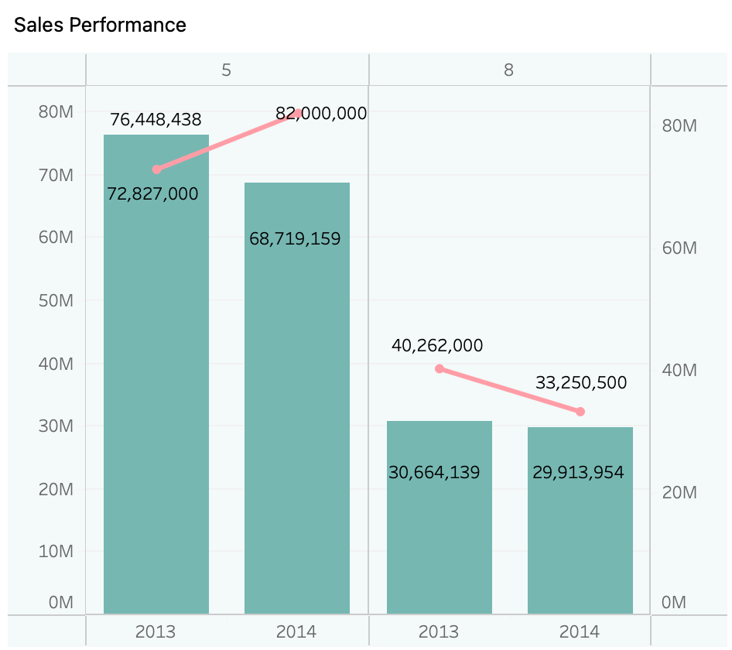
Store 5 Strengths & Weaknesses
Strengths:
Profitable overall in both years
Strong performance in 2013
Weaknesses:
Sharp drop in 2014 performance
Target missed significantly
Sales trend suggests risk if not corrected

Slide 5
Susan and Noushin
Give an overall assessment of Stores number 5 and 8’s sales.
How are they performing compared to target? Will they meet their 2014 target?
Should either store be closed? Why or why not?
What should be done in the next year to maximize store profits?

Slide 6
Bonus Recommendation – Objective & Methodology
Objective
Recommend separate bonus amounts for Store 5 & Store 8 in 2013 and 2014
Total 2013 Bonus Pool: $500,000
Total 2014 Bonus Pool: $400,000
Bonus allocation based on how well each store sold Men's & Women's Casual products
Methodology
We combined sales of Men's & Women's Casual by store & year
For each year, calculated each store's percentage share of total sales across both product types
Multiplied that share by the yearly bonus pool
Formula: Bonus = Pool * (Store Sales / Total Year Sales)
Ensures the bonus allocation is fair, data-driven, and linked directly to performance

Slide 7
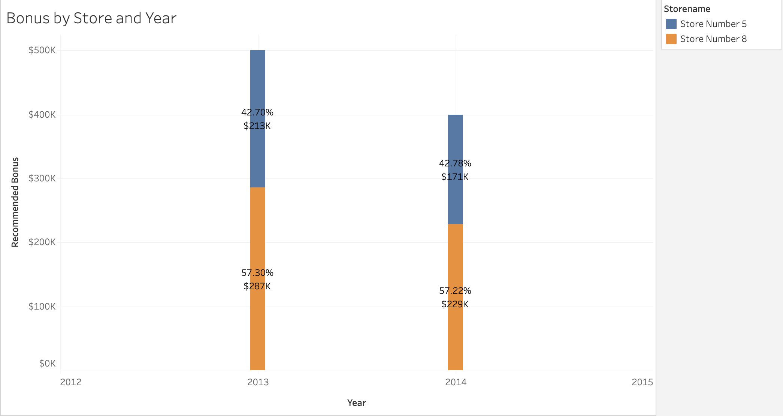
Bonus Allocation Per Store & Year
2013
Store 5 generated 42.7% of total sales ($10.2M)
Earns $213,496 of bonus pool
Store 8 generated 57.3% of total sales ($13.7M)
Earns $286,504 of bonus pool
2014
Store 5 generated 42.8% of sales ($9.2M)
Earns $171,127 of bonus pool
Store 8 generated 57.2% of sales ($12.3M)
Earns $228,873 of bonus pool
Store 8 consistently outperforms Store 5 in total sales of Men's & Women's Casual, so it earns a larger share of the bonus pool in both years.
Notes:
Bonus Allocation (Bar Chart)
In 2013:
Store 5 generated 42.7% of total sales ($10.2M), so it earns $213,496.
Store 8 generated 57.3% of sales ($13.7M), so it earns $286,504.
In 2014:
Store 5’s share was 42.8% ($9.2M), for a bonus of $171,127.
Store 8’s share was 57.2% ($12.3M), for a bonus of $228,873.
Rationale: Store 8 consistently outperformed Store 5 in total sales of Men’s & Women’s Casual, so it earns a larger share of the bonus pool in both years.

Slide 8
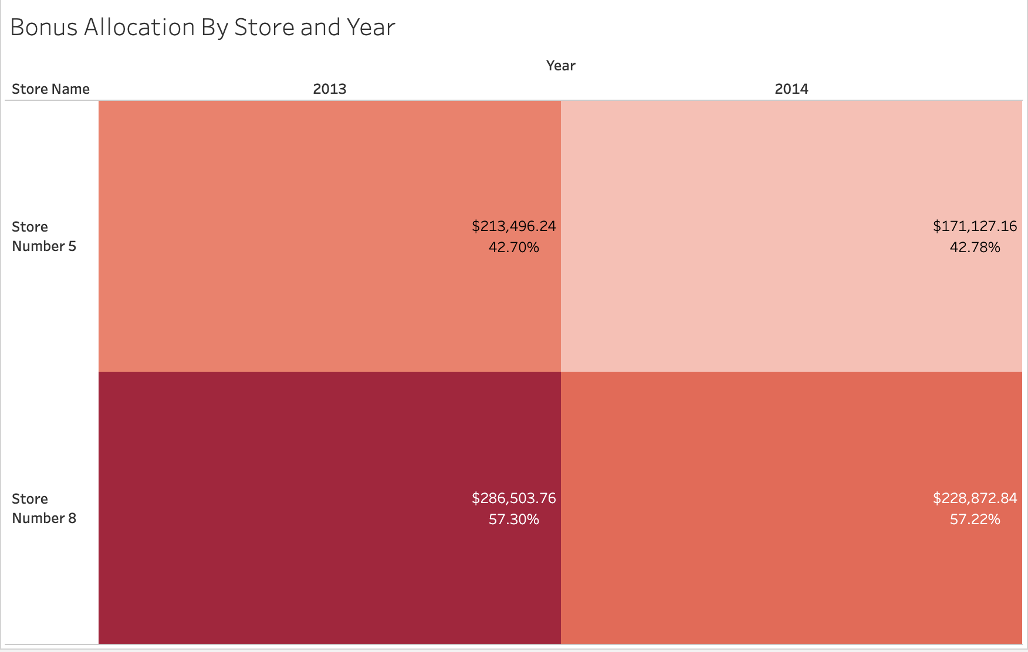
Bonus Allocation Per Store & Year
2013
Pool is $500,000
Store 8 has a darker shaded cell, indicating it earns a higher share of the pool.
2014
Pool shrinks to $400,000
Store 8 still shows a darker cell, earning a larger share of the pool again
Heatmap immediately shows rationale of allocation
Larger sales = darker cells = larger slice of pool
Reinforcing fairness
Bonus tied directly to performance in the product types
Did performance change?
No, Store 8 dominated sales in both years, Store 5 could not close gap
Notes:
Here, the heatmap clearly shows the allocation of bonus dollars. In 2013, Store 8 earned a darker cell, meaning it received the majority of the $500,000 pool, reflecting its stronger casual sales. Store 5’s lighter shade shows a smaller share. By 2014, with the pool reduced to $400,000, Store 5 didn't improve its relative performance, so the difference between stores remained. This visual justifies the recommendation: each store’s bonus aligns directly with its contribution to Men’s and Women’s Casual sales

Slide 9
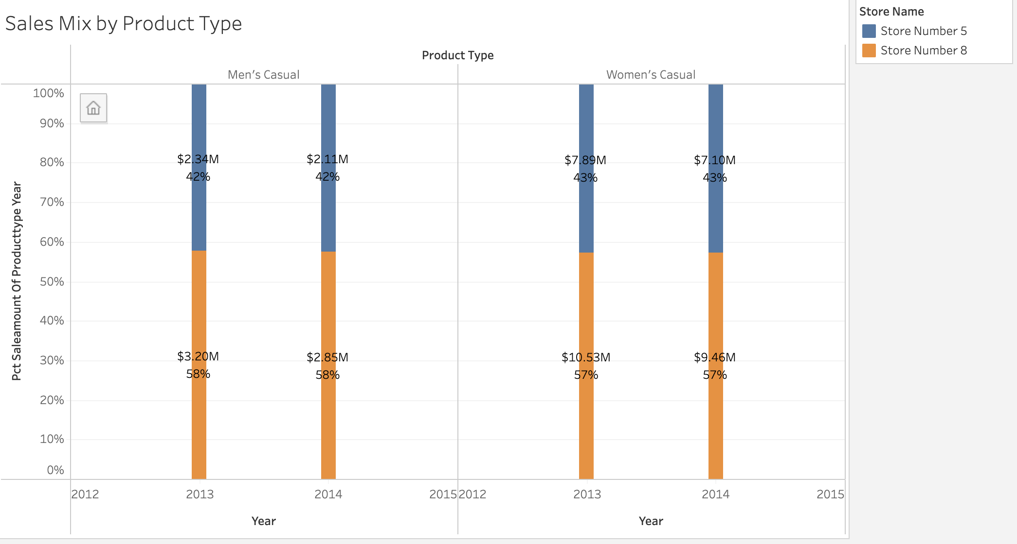
Product Sales Per Store & Year
Broken down further by Product Type
Store 5 consistently contributed around 42-43% of sales in both product types
Store 8 sold 57-58% of each product type in both years
Because Store 8 outperformed across both Men's and Women's Casual each year, the proportional bonus split is justified
Store 8's performance was stronger in both product types each year
Notes:
Sales Mix by Product Type (Stacked Bars)
Breaking it down further by product type:
Store 8 sold 57–58% of Men’s Casual in both years.
Store 8 also sold 57% of Women’s Casual in both years.
Store 5 consistently contributed around 42–43% in both categories.
Rationale: Because Store 8 outperformed across both Men’s and Women’s Casual, the proportional bonus split is justified—it wasn’t just strong in one category, but in both.

Slide 10
Bonus Recommendation & Next Steps
Bonus Allocation
1
2013: allocate $213,496.24 to Store 5 and $286,503.76 to Store 8
2014: allocate $171,127.16 to Store 5 and $228,872.84 to Store 8
Rationale
2
Store 8 consistently generates the larger revenue share in the target product types, therefore they receive the larger share of the pool
While Store 5 generates a smaller share, they still earn a significant portion of the bonus pool, reflecting its steady contributions
Next Steps
3
The company can continue using this method as the standard approach for future bonus allocations
Optionally, can try variations (using profitability over sales, apply weights to Men's or Women's Casual based on desired emphasis by leadership)

Slide 11
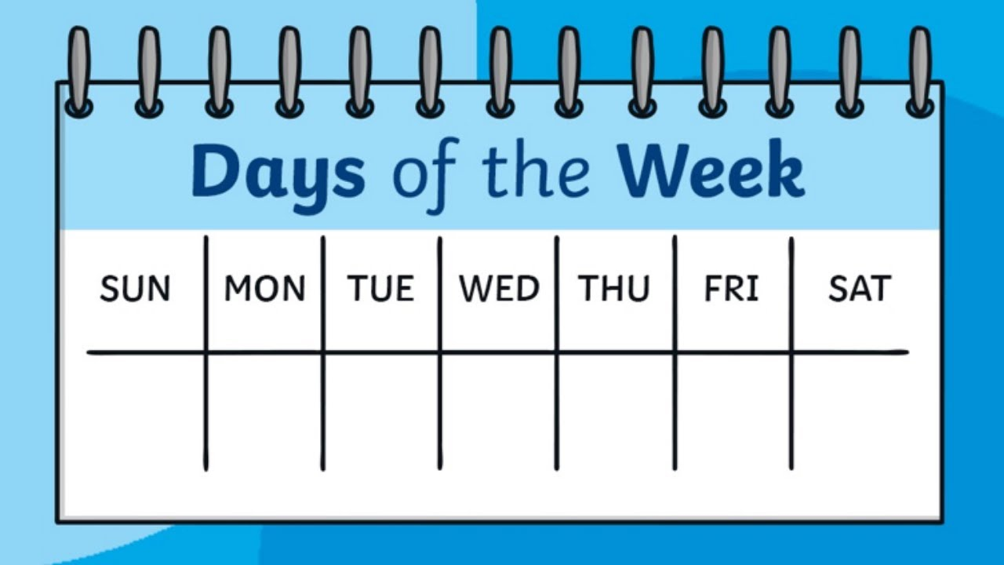
Sales Trends by Day of the Week
Store 5 vs. Store 8
2013-2014
Sunday to Saturday

Slide 12
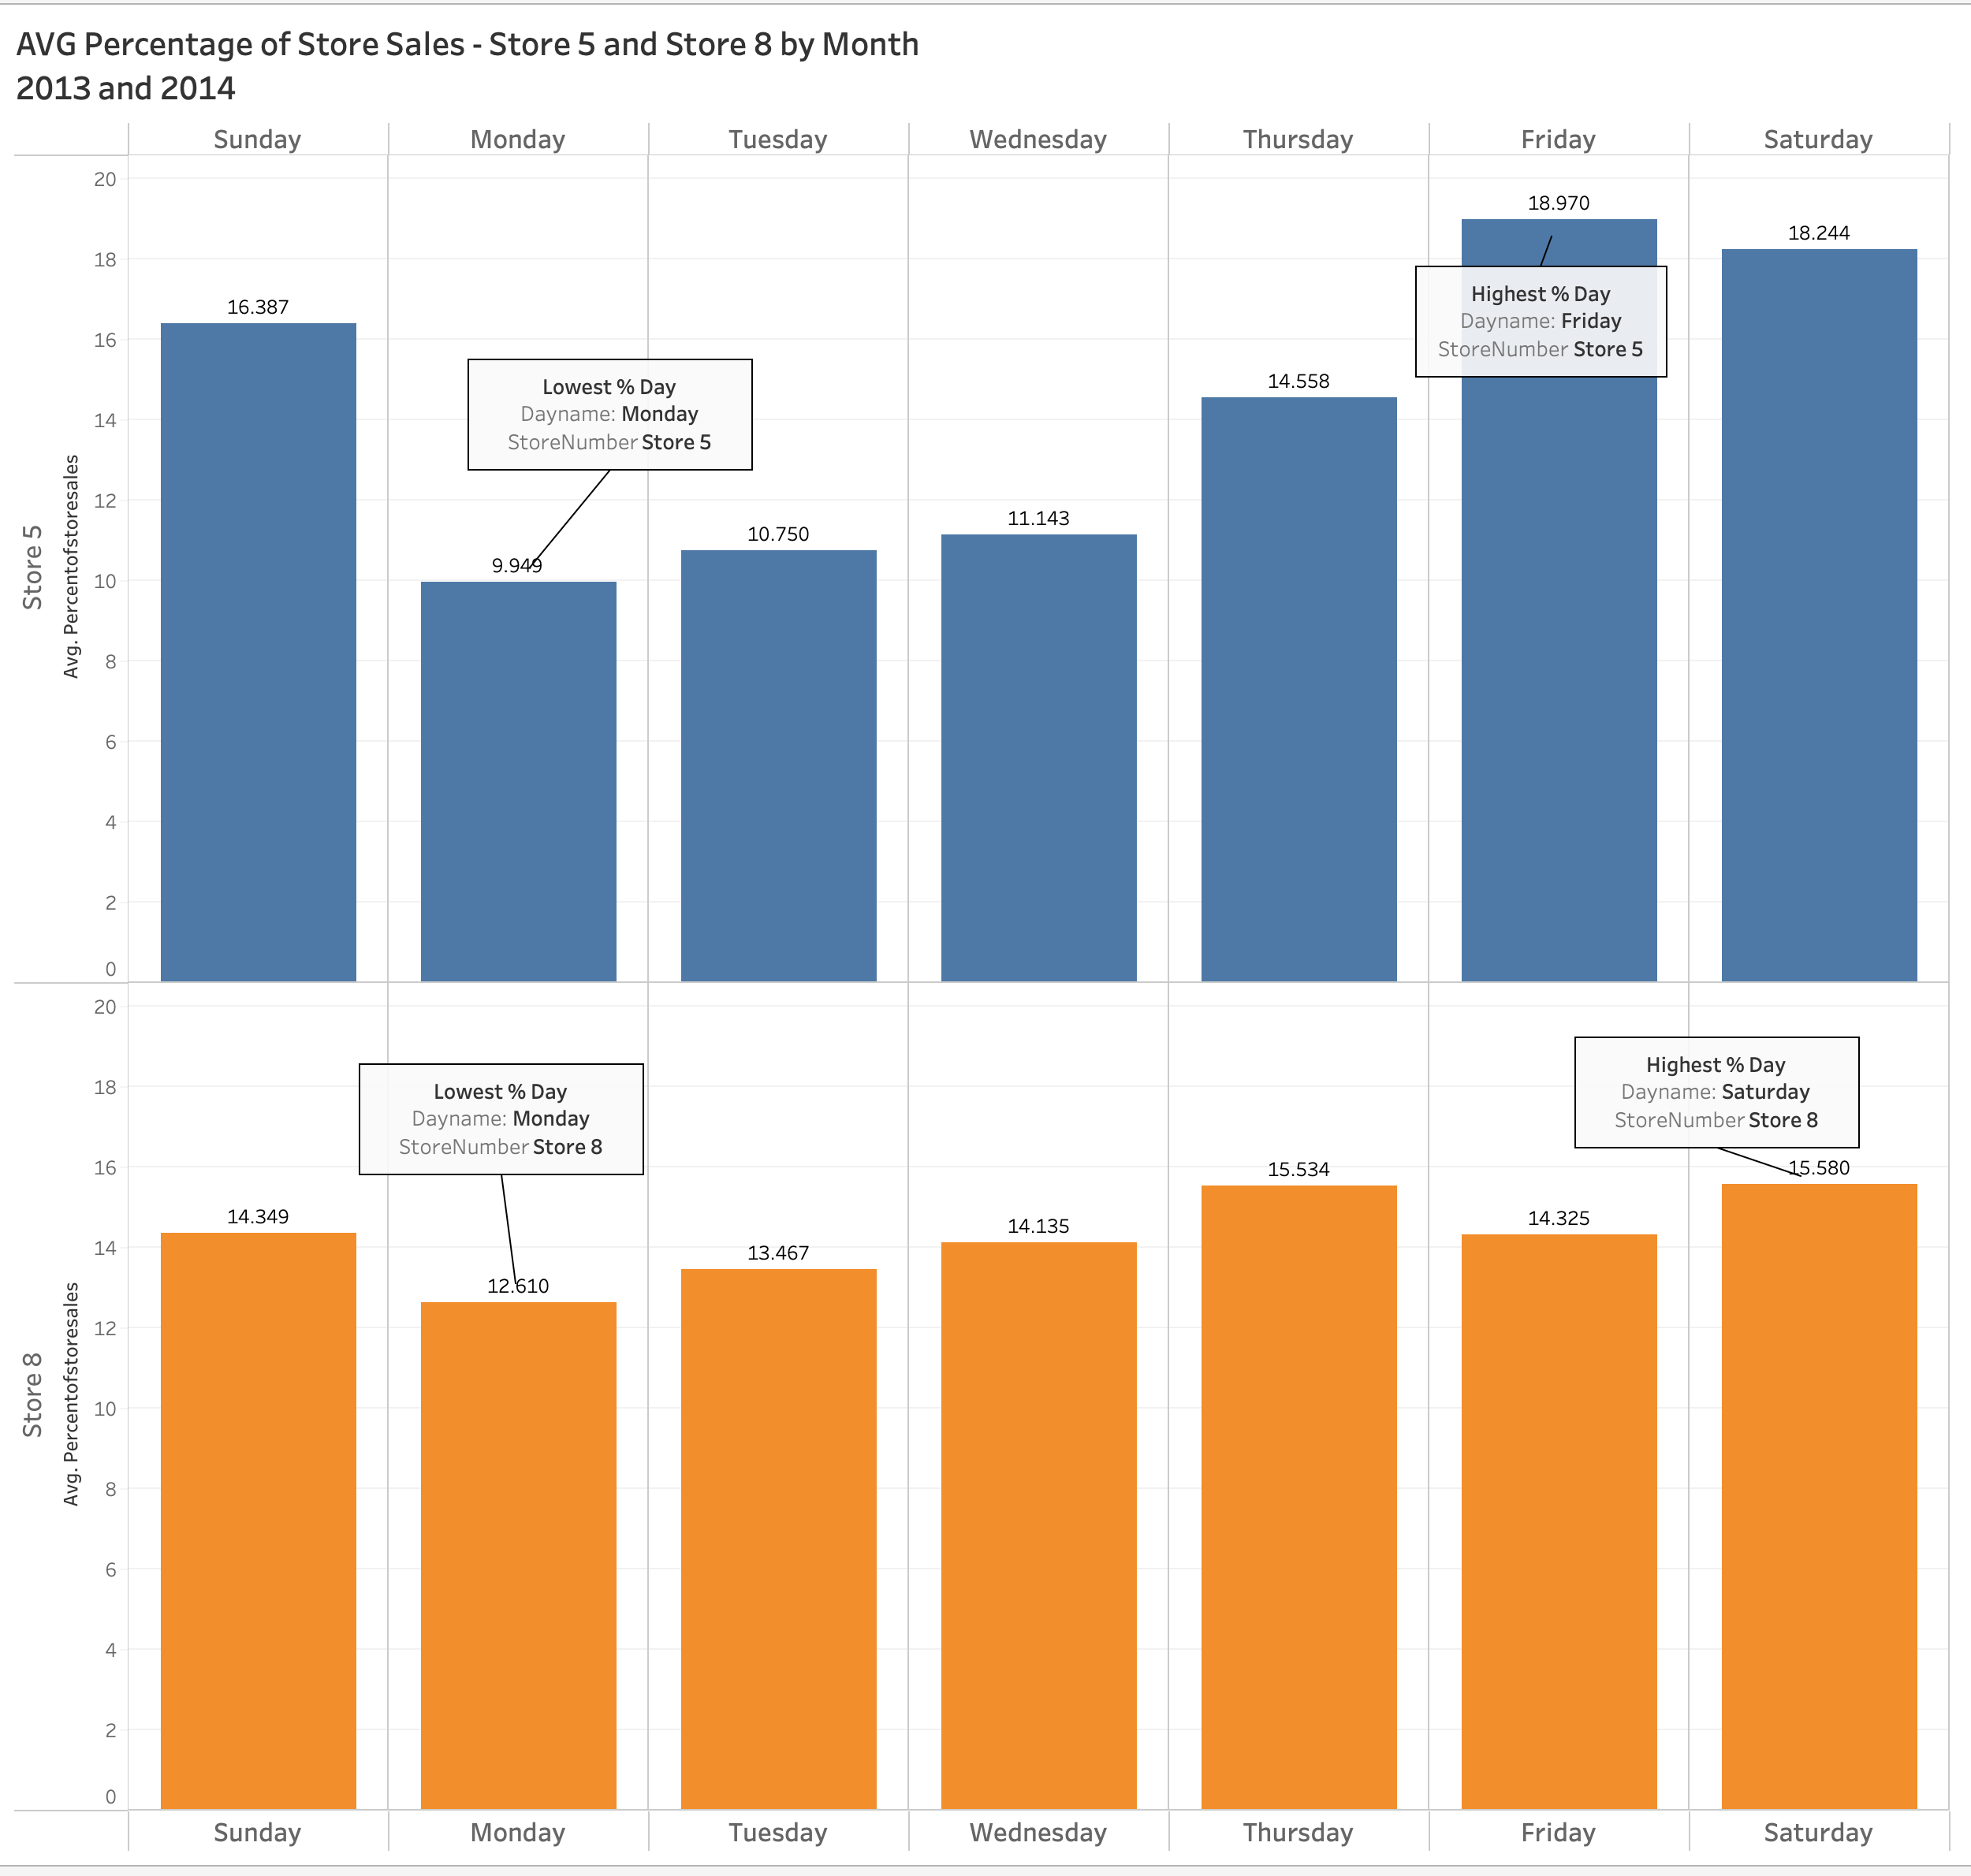
Trends by Day of Week
The weekend is when most of the sales for both stores occur.
Store 5 highest % of Sales = Friday
Store 8 highest % of Sales = Saturday
Store 5 lowest % of Sales = Monday
Store 8 lowest % of Sales = Monday
Scientific Conclusion: No one in the world likes Mondays.

Slide 13
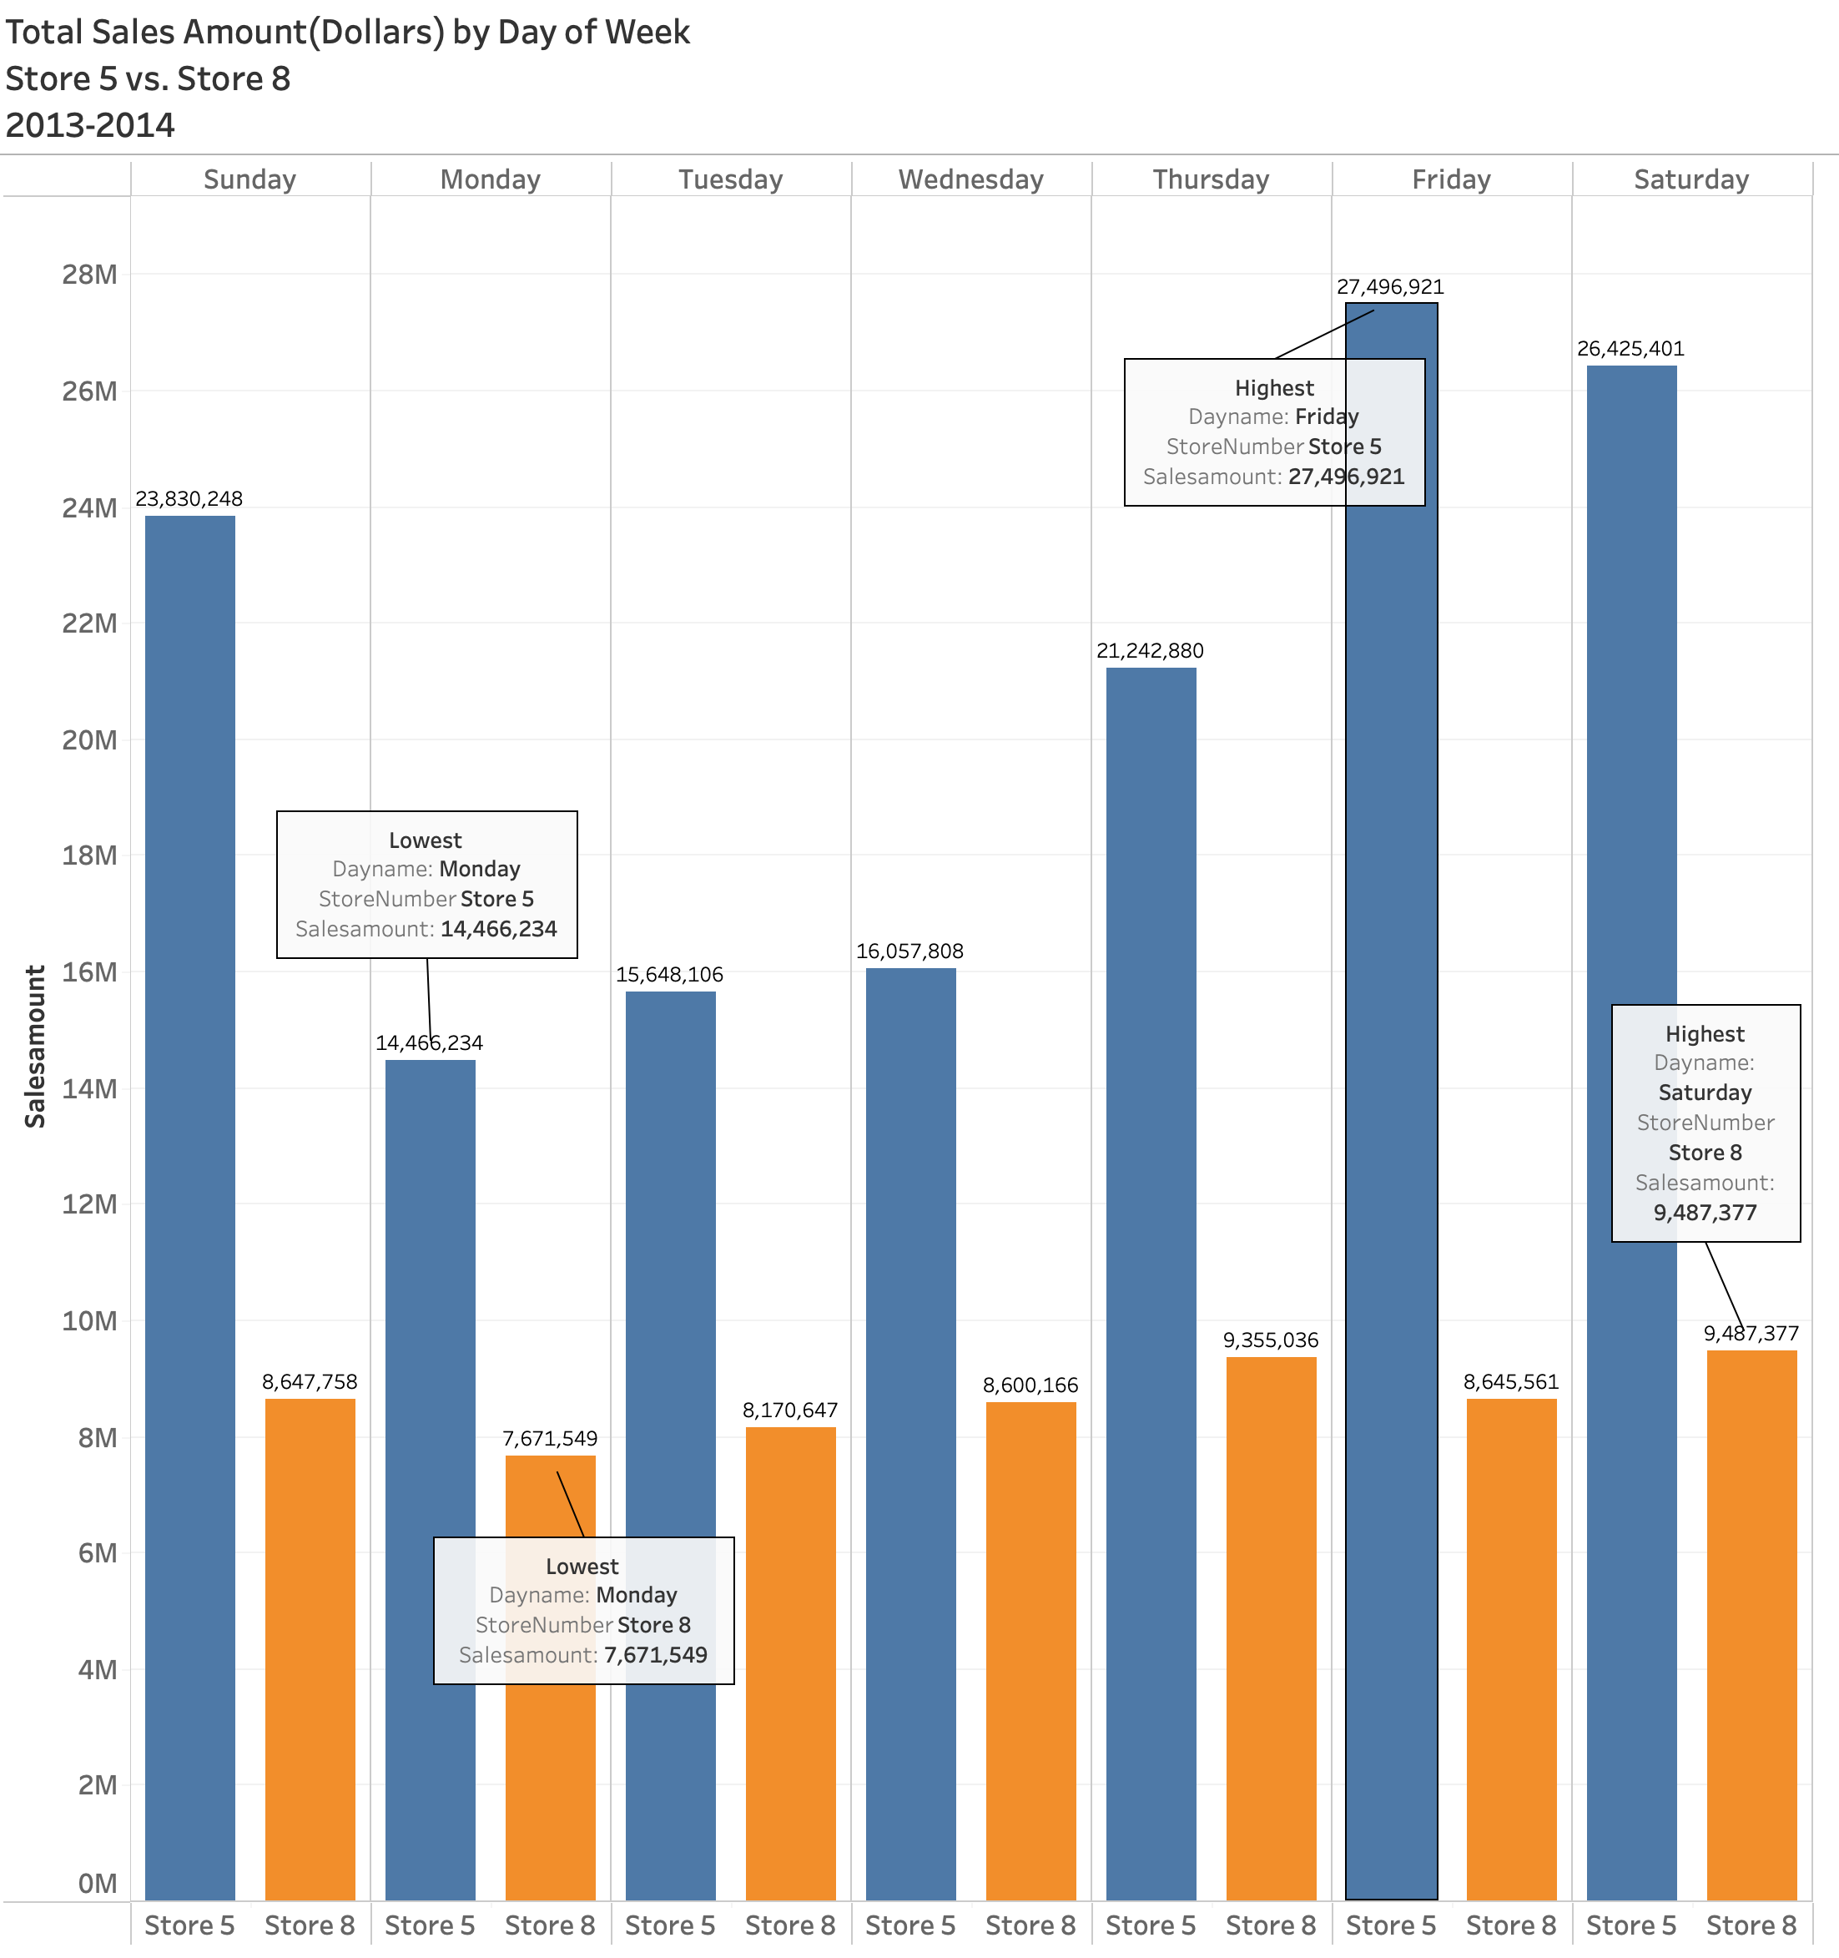
Trends by Day of Week
Store 5 overall Sales Amount overall higher than Store 8 everyday.
While Store 8 Sales Amount increase on the weekend, Store 5 Sales Amount increase significantly more.
Based on Day of Week, Store 5 (blue) sales also fluctuate much more than Store 8 does.

Slide 14
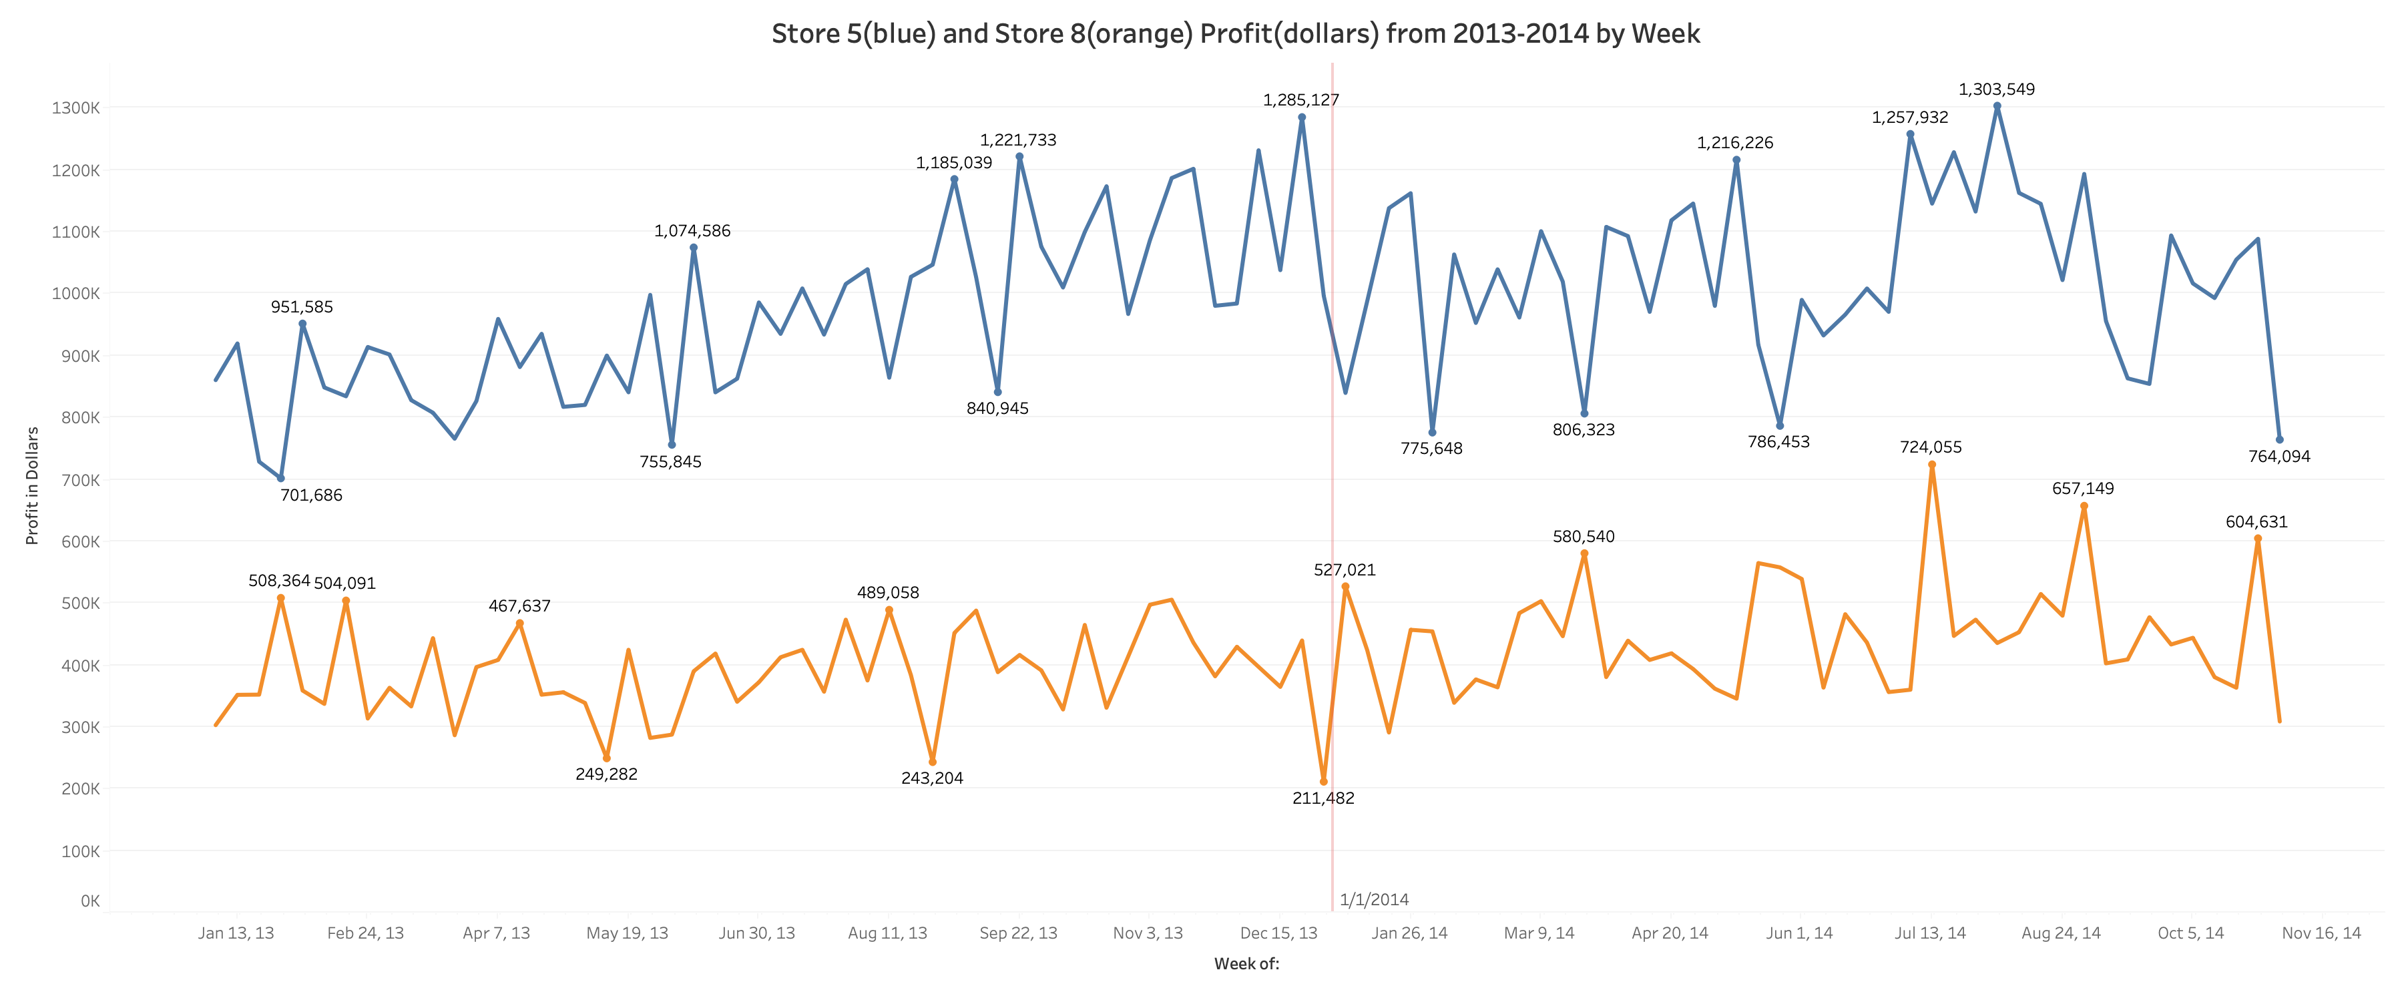

Slide 15
Things to Consider
Store 5
Atlanta, Georgia
Single Store State
Estimated population in 2013: 448,409
Estimated population in 2014: 456,002
Atlanta Open, PGA Tour, NASCAR, NFL, MLB, NBA, MLS, WNBA teams
Universities: 26 Public, 24 Private
Store 8
Little Rock, Arkansas
Multi-Store State
Estimated population in 2013: 197,369
Estimated population in 2014: 197,706
Universities: 10 Public, 12 Private

Slide 16
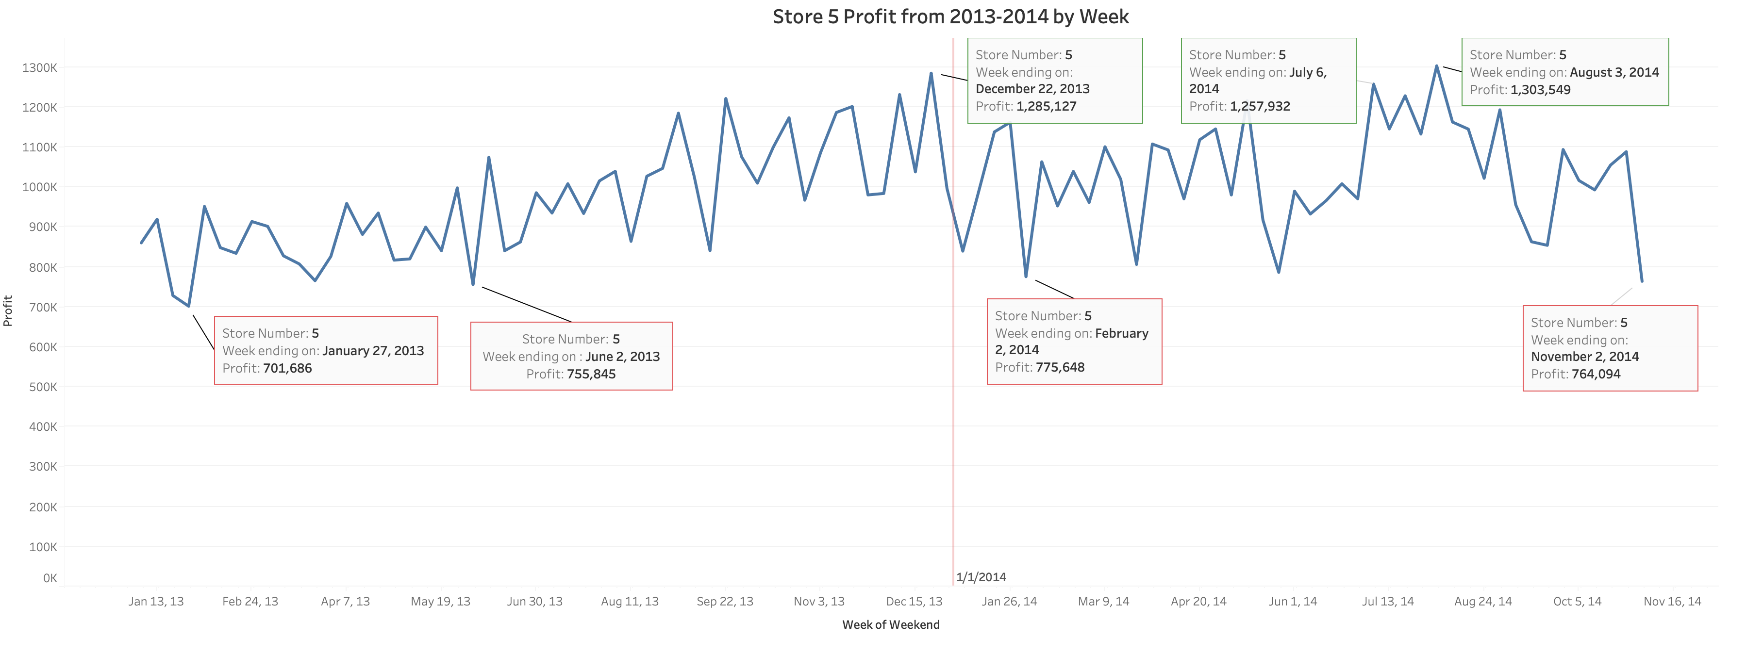

Slide 17
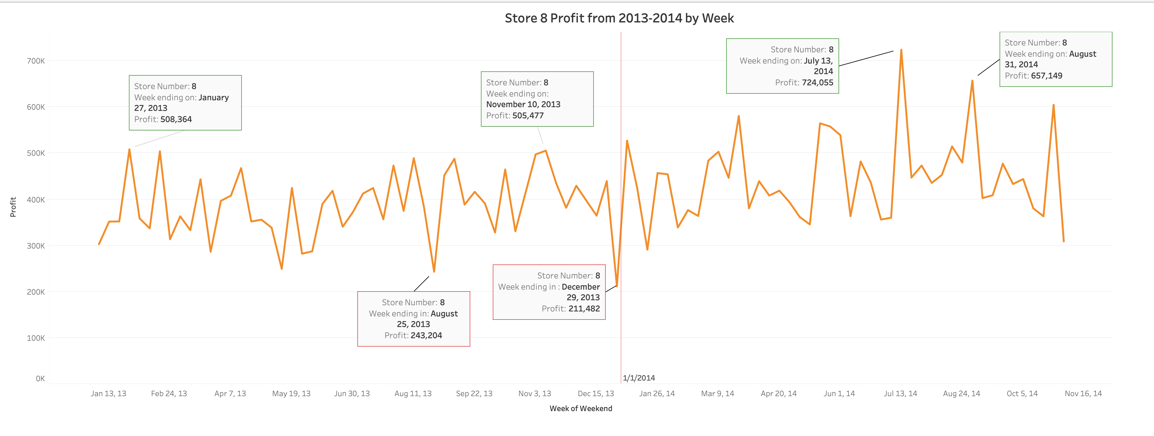

Slide 18

Implications and Recommendations
Staff and Stock heavier Friday/Saturday, especially for Store 5
Consider utilizing Monday for promotional events and sales.
Avoid overstacking weekend promos​
Reduce large sales on items during periods where they will already be in high demand​

Slide 19
Single Store vs Multi-Store State Performance
Question: What can we learn about having more than one store in a state?
Objective
Comparing all stores in single-store states versus all stores in multi-store states
Identifying the patterns in total sales and average sales amount (average per store)
Interpreting for location strategy for all stores

Slide 20
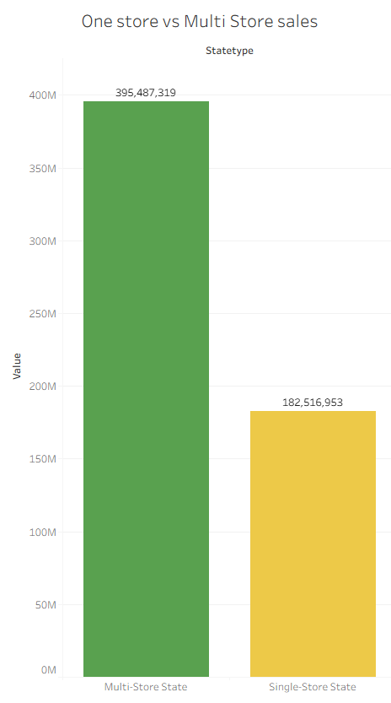
Overall Performance For Store 5 and 8
Multi store = $395,487,319
Single store = $182,516,953

Slide 21
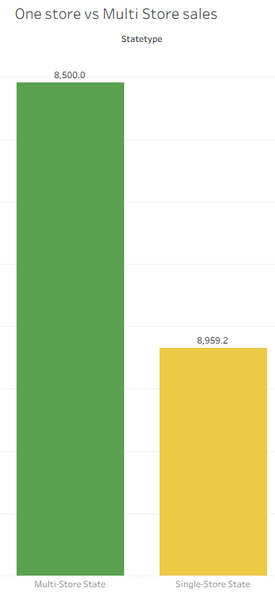
Average Sale Amount for Store 5 and 8
Multi store states average about $8,500 per sale.
Single store states average about $8959.20 per sale.

Slide 22
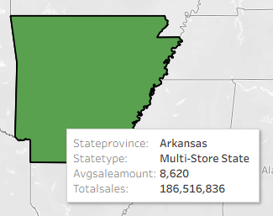
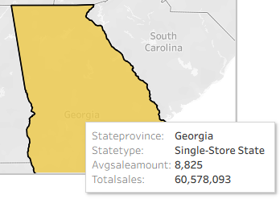
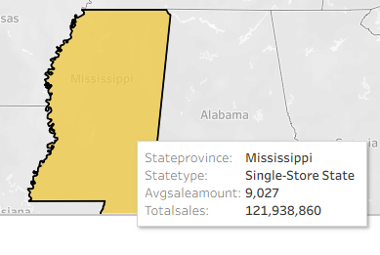
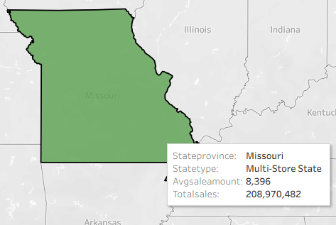
State By State Overall Examination
Arkansas: average sales amount = $8620 and total sales = $186.5M.
Georgia: average sales amount = $8825 and total sales = $60.6M.
Mississippi: average sales amount = $9026 and total sales = $121.9M.
Missouri: average sales amount = $8396 and total sales = $208.10M.

Slide 23

Key Findings
Multi-store states overperform in total sale revenues compared to single-store states ($395.5M vs $182.5M).
Single-store states get ahead with average sale value ($8959 vs $8500), despite their lone store presence.
Arkansas (multi-store) delivers strong total revenue but still slightly below the highest performer in the group regarding average sales amount.
Georgia (single-store) shows overall lone-store presence in total venues but still maintains a stronger average sales amount compared to other multi-state stores.
Mississippi (single-store) leads as winner for average sales amount despite low total revenue – a potential expansion may benefit from this.
Missouri (multi-store) leads as winner for total sales despite lower average sales amount.

Slide 24

What Can We Learn From Having Single-Store VS Multi-Store?
Multi-stores states can generate high sales total without hurting the average sales performance.
More locations = more sales.
Single-store states are candidates for possible expansion.
Adding locations to these single-store states can expose new revenues while maintaining strong average sales amount.

Slide 25

Location Strategy Recommendations
Multi-stores states can hold steady for now.
Refine product mix.
Enhance customer experience and satisfaction.
Consolidate underperforming locations if necessary.
Adding more focus on the single-store states toward higher potential earnings for total sale revenues.
Most importantly, pair store expansions with high-value markets for the purpose of maximizing overall performance.

Slide 26

Thank you for listening to our presentation!

Slide 27
References
https://www2.census.gov/programs-surveys/popest/tables/2010-2014/cities/totals/PEPANNRSIP.pdf

